Slide 1

Chapter 3:
Pattern Discovery in Data Mining
Notes:
‹#›

Slide 2
Mining Spatiotemporal and Trajectory Patterns
Objective
Explanation of spatiotemporal and trajectory patterns and their relevance
Techniques and algorithms for mining spatiotemporal and trajectory patterns
Use cases and applications of these patterns in various domains
‹#›

Slide 3
Mining Spatiotemporal and Trajectory Patterns
Objective
Explanation of spatiotemporal and trajectory patterns and their relevance
Techniques and algorithms for mining spatiotemporal and trajectory patterns
Use cases and applications of these patterns in various domains
‹#›

Slide 4
Mining Spatiotemporal and Trajectory Patterns
Spatial Frequent Patterns and Associations
Spatial frequent patterns and association rule: A ⇒ B [s%, c%]
  A and B are sets of spatial or non-spatial predicates, e.g.,
    Topological relations: intersects, overlaps, disjoint, etc.
    Spatial orientations: left_of, west_of, under, etc.
    Distance information: close_to, within_distance, etc.
    Measures: s%: support, and c%: confidence of the rule
  Example: Rules likely to be found
    is_a(x, large_town) ^ intersect(x, highway) → adjacent_to(x, water) [7%, 85%]
  Explore spatial autocorrelation: Spatial data tends to be highly self-correlated (nearby things are more related than distant ones)
    E.g., neighborhood, temperature
‹#›

Slide 5
Mining Spatiotemporal and Trajectory Patterns
Mining Spatial Associations: Progressive Refinement
Hierarchy of spatial relationship:
  close_to is a generation of near_by, touch, intersect, contain, ...
  Progressive refinement: First search for rough relationship and then refine it
Two-step mining of spatial association:
  Step 1: Rough spatial computation (as a filter)
    Using MBR (Minimum Bounding Rectangle) or R-tree for rough estimation
  Step2: Detailed spatial algorithm (as refinement)
    Apply only to those objects which have passed the rough spatial association test (no less than min_support)
‹#›

Slide 6
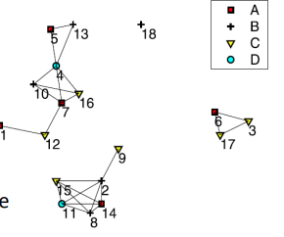
Mining Spatiotemporal and Trajectory Patterns
Spatial Colocation Patterns
Colocation pattern: A group of spatial features or events that are frequently co-located in the same region
  Ex. West Nile Virus often occur in regions with poor mosquito control and the presence of birds
Figure: Neighborhood instances are connected by edges
  Ex. {3, 6, 17}, {4, 7, 10, 16}, {2, 8, 11, 14, 15}, {2, 9}, …
‹#›

Slide 7
Mining Spatiotemporal and Trajectory Patterns
Spatial Colocation Patterns
Rowset(C) if every feature in patter C appears as a feature of an instance in the neighbor-set L, e.g., rowset({A, B, C, D}) = {{4, 7, 10, 16}, {2, 11, 14, 15}, {8, 11, 14, 15}} rowset({A, B}) = {{5, 13}, {7, 10}, {2, 14}, {8, 14}}
A colocation rule R: A→ B, conditional probability cp(R) is defined as
  cp({A, B} → {C, D}) = |rowset({A, B, C, D})|/|rowset({A,B})| = ¾ = 75%
‹#›

Slide 8
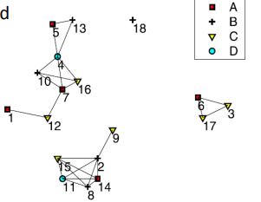
Mining Spatiotemporal and Trajectory Patterns
Mining Spatial Colocation Patterns
Participation ratio pr(C, f ): probability that C is observed in a neighbor-set wherever feature f is observed
  Ex. pr({A,B,C,D}, A) = 2/5, ..., pr({A,B,C,D}, D) = 2/2 = 1
Monotonicity of participation ratio
  Let C, C’ be two co-location patterns such that C’ ⊂ C
    Then, for each feature f ∈ C’, pr(C’, f ) ≥ pr(C, f )
‹#›

Slide 9
Mining Spatiotemporal and Trajectory Patterns
Mining Spatial Colocation Patterns
An Apriori-like algorithm can be derived for efficient mining colocation patterns
  Ex: Let min-feature-support = σ, min-pr = ρ
    Start with a set of single feature pattern {p1} with support ≥ σ
      Grow to size k, in Apriori way (i.e., stop growing if the pattern is infrequent)
      For each such p, mine its super-pattern P, s.t., pr(P, p) ≥ ρ, in Apriori way
‹#›

Slide 10
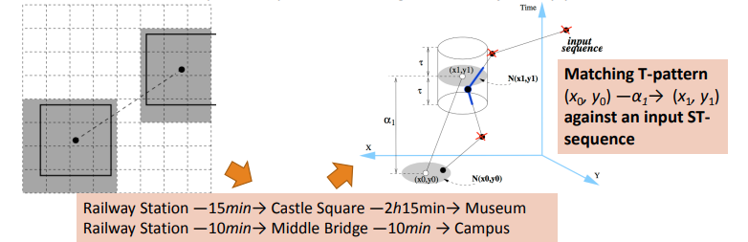
Mining Spatiotemporal and Trajectory Patterns
Partition-Based Trajectory Pattern Mining
Partition-Based Trajectory Pattern Mining (e.g., Mining T-Patterns) [1]:
  First partition the space into equal-width grids and obtain Regions-of-Interests (RoIs)
  Then transform each input trajectory into a time-annotated symbolic sequence
  Use constraint-based sequential pattern mining to find trajectory patterns
‹#›

Slide 11
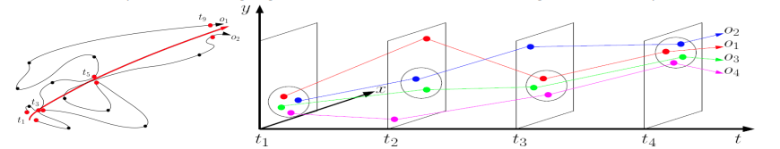
Mining Spatiotemporal and Trajectory Patterns
Detecting Moving Object Clusters
Flock and convoy: Both require k consecutive time stamps
  Flock: At least m entities are within a circular region of radius r and move in the same direction
  Convoy: Density-based clustering at each timestamp; no need to be a rigid circle
Swarm: Moving objects may not be close to each other for all the consecutive time stamps
  Efficient pattern mining algorithm can be derived for mining such swarm patterns
‹#›

Slide 12
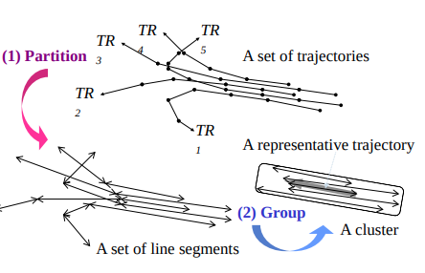
Mining Spatiotemporal and Trajectory Patterns
Trajectory Clustering: A Partition-and-Group Framework
Grouping trajectories as a whole ⇒ cannot find similar portions of trajectories
Solution: discovers common sub-trajectories, e.g., forecast hurricane landfall
Two phases: partitioning and grouping
Identify the points where the behavior of a trajectory changes rapidly ⇒ characteristic points
  Based on the minimum description length (MDL) principle
‹#›

Slide 13
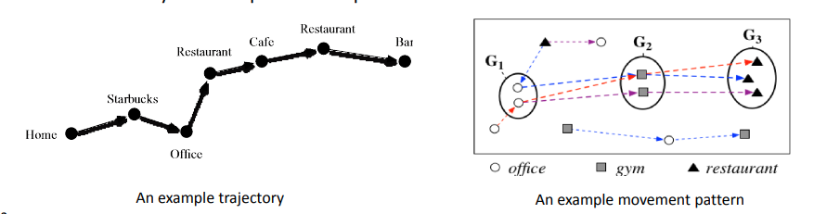
Mining Spatiotemporal and Trajectory Patterns
Mining Frequent Movement Patterns
Frequent Movement Pattern: A movement sequence that frequently appears in the input trajectory database
Frequent Movement Pattern vs. Frequent Sequential Pattern
  Both aim at finding frequent subsequences from the input sequence database
  For mining frequent movement patterns, similar places may need to be grouped to collectively form frequent subsequences
‹#›

Slide 14
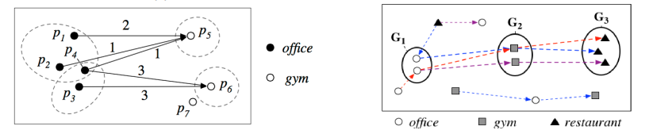
Mining Spatiotemporal and Trajectory Patterns
Mining Semantics-Rich Movement Patterns
Semantics-rich movement pattern: In addition to knowing how people move from one region to another, we also want to understand the functions of the regions
A two-step top-down mining approach: Step 1: Find a set of coarse patterns that reflect people’s semantics-level transitions (e.g., office → restaurant, home → gym) Step 2: Split each coarse pattern into several fine-grained ones by grouping similar movement snippets
‹#›

Slide 15
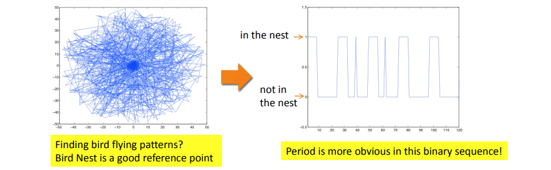
Mining Spatiotemporal and Trajectory Patterns
Pattern Discovery in Sparse Movement Data: Finding Good Reference Points
Pattern discovery in sparse data (e.g., find bird flying patterns)
  Periodicity shows up in some reference “spots” (or “cluster centers”)
  Reference spots can be detected using density-based method
  Periods are detected for each reference spot using Fourier Transform and auto-correlation
‹#›

Slide 16
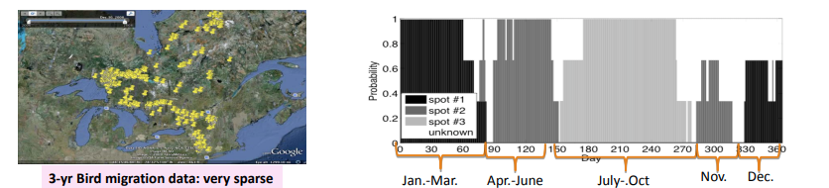
Mining Spatiotemporal and Trajectory Patterns
Example: Mining Periodic Patterns with Sparse Data
Detecting periods: Cluster data to find reference “points” and then detect multiple interleaved periods by Fourier Transform and auto-correlation
Summarizing periodic patterns: By clustering and pattern discovery
‹#›

Slide 17
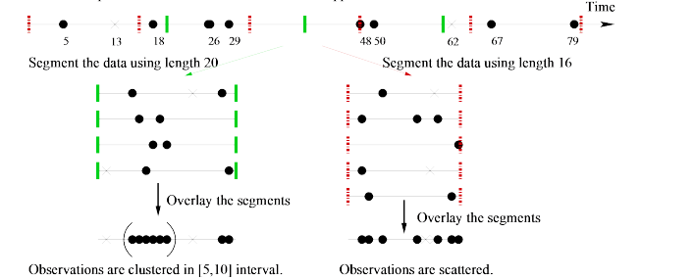
Mining Spatiotemporal and Trajectory Patterns
Periodicity Detection in Sparse Data
Time-related data can be scattered and sparse, e.g., phone calls at a location
Projecting on the true period, it shows a highly skewed (clustered) distribution
Effective method can be developed based on this observation
‹#›

Slide 18
Summary
Spatiotemporal Pattern Mining
Patterns in space and time.
Specialized algorithms.
Applications in transportation, planning, epidemiology.
‹#›

